Slide 1
Sensors, instruments and Experimentation
Introduction by Ashok Ranade

Slide 2
Syllabus
Introduction to construction and characteristics of sensors. Experiments involving application of sensors for physical quantities like temperature, pressure, force, torque, strain, velocity, acceleration, linear and angular speed and displacement, volumetric and mass flow rates, illumination, and sound level etc. Introduction to calibration of sensors and data acquisition system
Basic Mechanical measuring instruments: Vernier caliper: Micrometer: Coordinate Measuring Machine: Pressure gauge :

Slide 3
Books
Principles and applications of Electrical
Engineering
Fifth Edition
By Giorgio Rizzoni
McGraw-Hill (India)
References on the net

Slide 4
Examination scheme
Quiz 1 : 11%
Mid term test: 22%
Quiz 2 : 6%
Assignments : 11%
Project: 15%
End term Examination : 35%
All examinations open book and on LMS

Slide 5
Grade Rubric
Absolute grading
Grades | A | A- | B+ | B | B- | C+ | C | D | NP
Marks Range | 90-100 | 80-89 | 70-79 | 60-69 | 50-59 | 40-49 | 35-39 | 30-34 | 0-29

Slide 6

Measurement and control systems
Engineering applications require measurement and control of physical quantities
Satellite communication
Antenna position

Slide 7
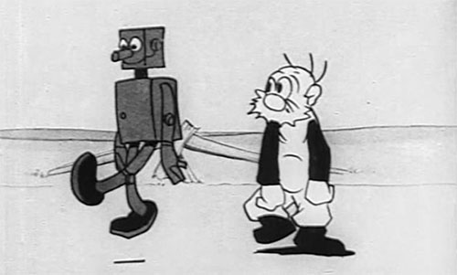
Robot position

Slide 8
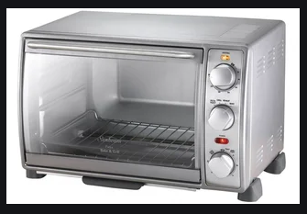

Other Examples
Measurement and control of temperature of oven
Measurement and control of Flow in flood control

Slide 9
Transducers
Capable of converting one physical quantity into another type of physical quantity
The device which converts a non-electrical quantity into an electric quantity is called a sensor
Examples
Thermocouple
Microphone
The device which converts an electrical quantity into a non electrical quantity is called actuator
Heater
Speaker

Slide 10

An application
Temperature alarm
Temperature
Sensor
Comparator
Vr

Slide 11
One more application
Speed and acceleration measurement
Speed
38 RPM
Speed sensor
A to D converter
Processor
Acceleration
4 m/sec²

Slide 12
Input output characteristics of a sensor
Manufacturers specify the sensor characteristics
x is the input
y is the output
y = f(x)

Slide 13
Sensor calibration
Source to vary
The input quantity
x
y
Accurate Meter for output quantity
Sensor
i.e. compressor
Heating element
If non linear manufacturer will also provide polynomial equation
Accurate meter for input quantity
If approximately linear, best fit line is given.
often a graph is provided by the manufacturer

Slide 14
Curve fitting
This is the process of finding a suitable equation between y and x when table of values of x and y is known.
Often a polynomial is found
The curve fitting will give the values of constants a₀,a₁ etc
Other equations are also possible
Many programming languages have the function for curve fitting
Excel also has the facility

Slide 15
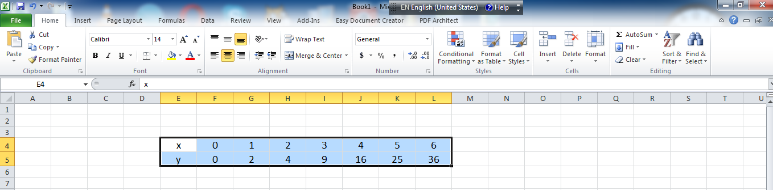
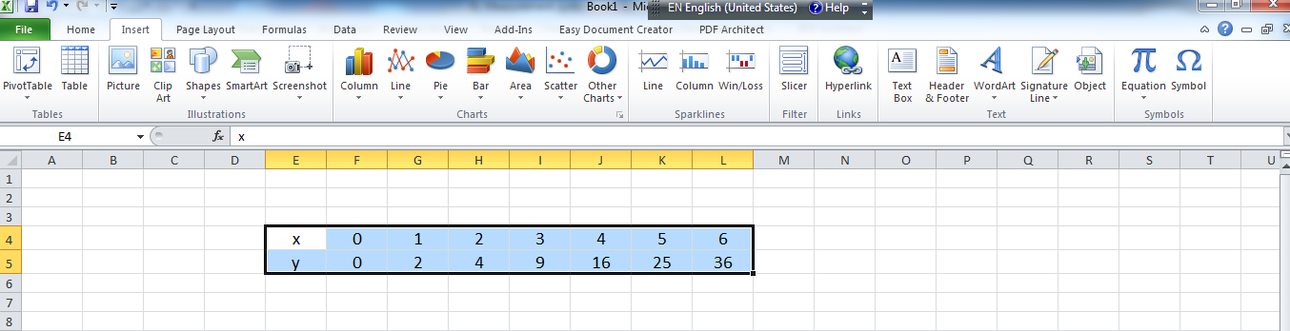

Slide 16
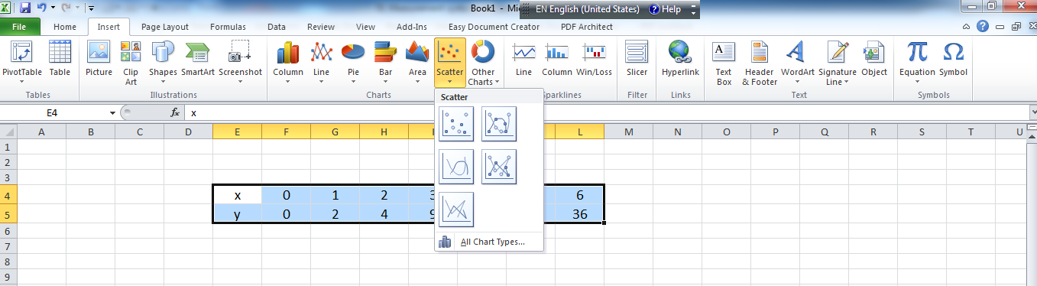
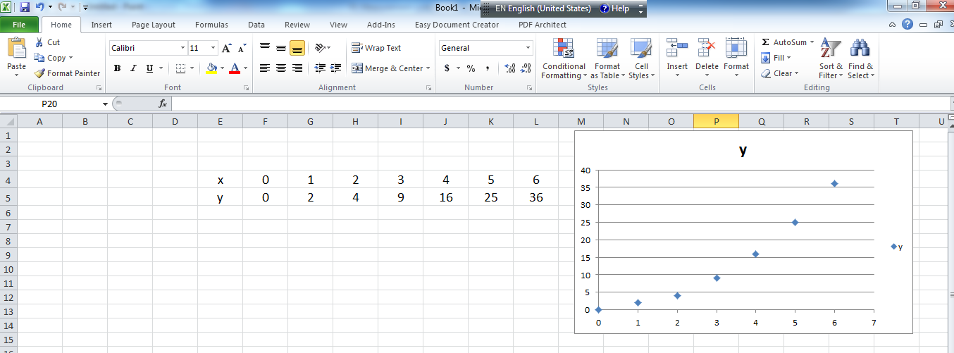

Slide 17
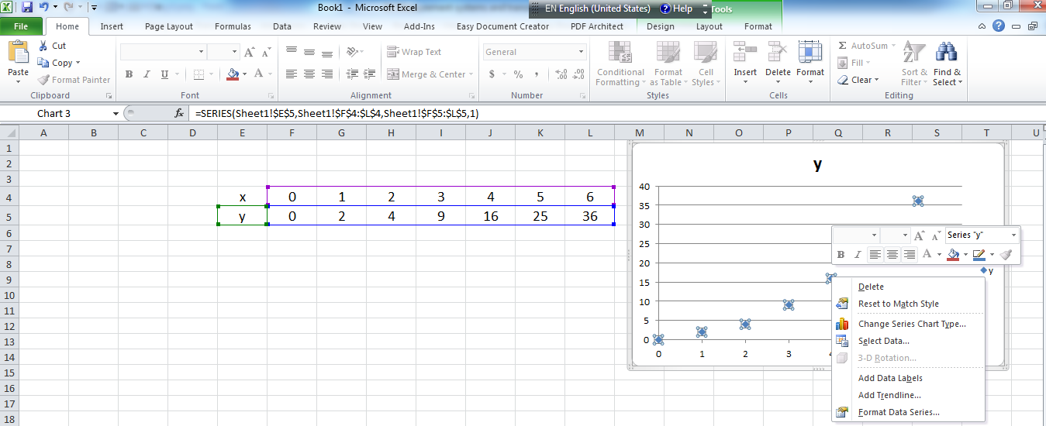

Slide 18
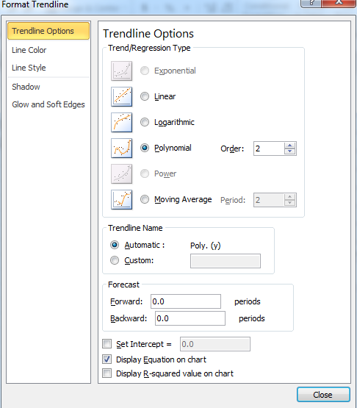

Slide 19
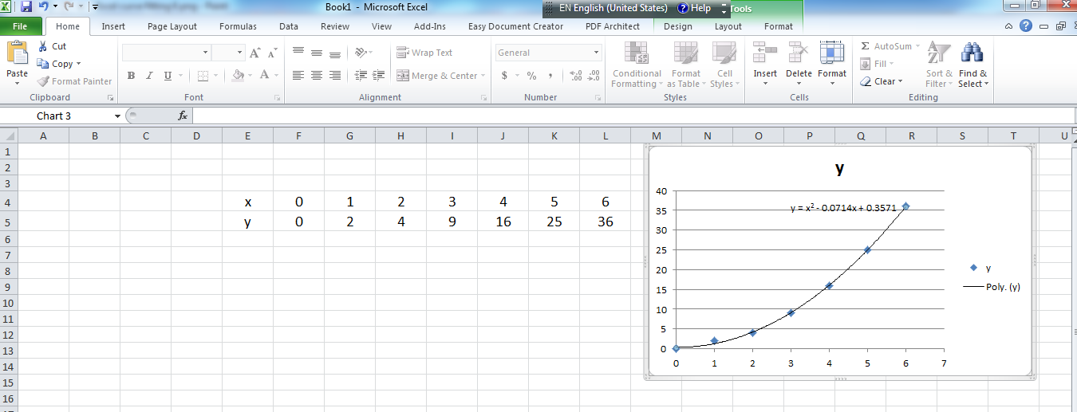

Slide 20
Class Exercise 1
Let x vary from 0 to 1 with increment of 0.1
Let y = x³
In Excel calculate y for each value of x and find
the polynomial for y in terms of x. It will be close to x³.
Calculate y using the polynomial and compare with original values

Slide 21
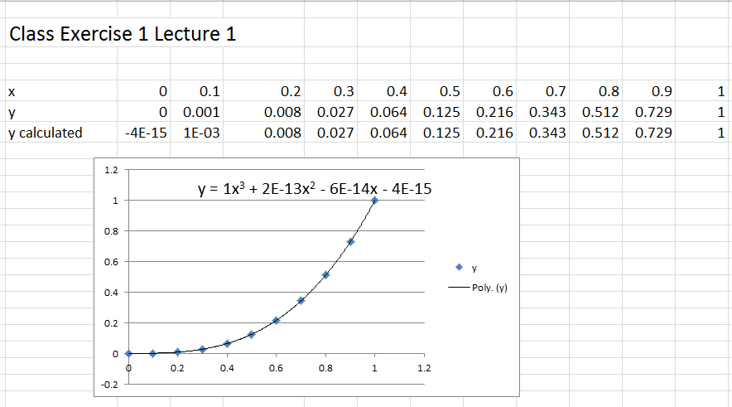
Solution to Exercise 1

Slide 22
Class Exercise 2
Let x vary from 0 to 1 with increment of 0.1
Let
In Excel calculate y for each value of x and find
the polynomial for y in terms of x. Calculate y using the polynomial and compare with original values.
Experiment with two or more trend-lines for more accurate results

Slide 23
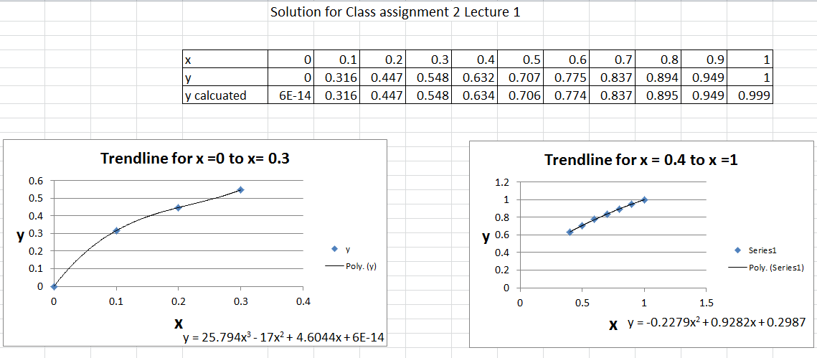
Solution to Exercise 2

Slide 24
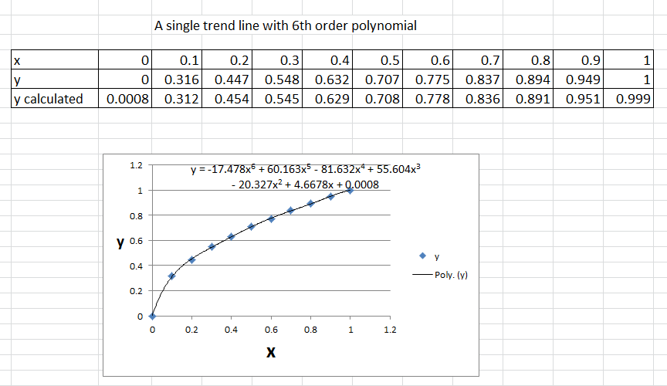
More error with single trendline

Slide 25
Sensors instruments and experimentation
02 Some aspects of instrument design and errors in measurements
By Ashok Ranade

Slide 26
Analog Instrument
Suppose we want to build an analog temperature measuring instrument with range of 0 to 100 degree C, using a given sensor and a voltmeter
Sensor characteristics are 10mV/degree centigrade
Voltmeter is 0 to 5 volts.
V= 0.01 T
Output of sensor is 1 volt at 100 degrees so for full scale deflection the amplifier with gain 5 is required
Vo = 0.05T
V
Amplifier
Gain 5
Vo
T
Sensor
Voltmeter

Slide 27
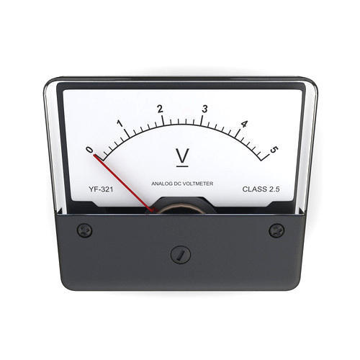
Calibrating the meter
Vo = 0.05T
T= Vo/0.05
Vo | T
0 | 0
1 | 20
2 | 40
3 | 60
4 | 80
5 | 100

Slide 28
Linear and non linear
x Temp | y₁(mV) | y₂(mV)
0 | 0 | 0
10 | 100 | 10
20 | 200 | 40
30 | 300 | 90
40 | 400 | 160
50 | 500 | 250
60 | 600 | 360
70 | 700 | 490
80 | 800 | 640
90 | 900 | 810
100 | 1000 | 1000
Output in mV
Temperature in degrees Centigrade
Scale is crowded at low temperatures for non linear sensor for analog display

Slide 29
Digital Instrument
A to D converter
Sensor
Processor
Display
In general
Table look up can be used instead of solving the equation. Will need memory.
Easy calculation for linear sensor
Difficult calculation for non-linear sensor

Slide 30
Algorithm for the Digital instrument
(1) Read y₁
(2) calculate x = f⁻¹(y₁) or get x from look up table
(3) Send to display
(4) Delay
(5) Go to (1)

Slide 31
Class Exercise 2.1
A force sensor has input output characteristics given
by
Where V is the output voltage and F is the force in
Newtons
We wish to build an analog Force meter which uses a voltmeter of the range 0-10 volts. The calibration should be valid for the force range from 0 to 10 Newtons. (Full scale). So in your block diagram you have Force sensor and 0 – 10 dc voltmeter. What else you need? Think and design the complete block diagram for the meter . Show the calibration so that you get one decimal digit accuracy.

Slide 32
Solution to Exercise 2.1
We have
So when F = 10 Newtons
V = 6.324555 volts
Clearly we can not get full scale deflection if we connect the output of sensor to the voltmeter. So we need an amplifier with gain = 10/6.324555
= 1.581139

Slide 33
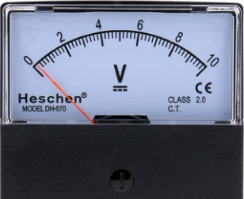
Block diagram
Vo
Force
sensor
F
Amplifier

Slide 34
Calibration
F | V | Vo
0 | 0 | 0
0.1 | 0.632 | 1
0.5 | 1.414 | 2.2
1 | 2 | 3.2
2 | 2.828 | 4.5
3 | 3.464 | 5.5
4 | 4 | 6.3
5 | 4.472 | 7.1
6 | 4.899 | 7.7
7 | 5.292 | 8.4
8 | 5.657 | 8.9
9 | 6 | 9.5
10 | 6.325 | 10
.5
1
2
3
4
5
.1
6
7
0
8
9
10

Slide 35
Exercise 2.2
Consider the block diagram below
A to D
Converter
Sensor
Attenuator
Processor
x
y
y₁
y₂
x | Y(Volts)
0 | 15
3 | 2
8 bit A to D converter is used and range of input voltage to ADC is 0 to 5 volts. Obtain the expression for x in terms of y₂ that processor will use
Display x

Slide 36
Solution to Exercise 2.2
Since ADC accepts the maximum input of 5 volts y₁ = y/3
Since ADC is 8 bit its output ranges from 0 to 255. And 255 corresponds to y₁ = 5. Also ADC is linear so
Substituting for y₁ and rearranging we get the final answer

Slide 37
Error in measurements
What is Error ?
Difference between measured and true value
usually in % of full scale reading
Accuracy
Conformity of the measurement to the true value

Slide 38
What is a true value ?
As measured by an instrument without error
This does not exist
However highly accurate instruments called Primary standards are available
These are available in International and National laboratories
Less accurate instruments are calibrated using Primary standards
These are secondary standards more often used
Working standards
These are calibrated using secondary standards

Slide 39
Calibration procedure
Source with regulator to control
the quantity under test
Instrument under test
Heat source
Compressor
Voltage source
Secondary or working standard

Slide 40
Types of Measurement errors
Two types of errors
Systematic errors
Due to instrument inaccuracies
Faulty design of an experiment
Repeatable
Random errors
Human errors
Noise
Not repeatable

Slide 41
Error distributions (Magnitude)
Systematic errors (Magnitude measurement)
True value
Measured values
Random Errors
True value
Measured values

Slide 42
Error distribution (Magnitude and phase)
Systematic errors
Measured values
True value
Magnitude
Phase

Slide 43
Error distribution (Magnitude and phase)
Random errors
Measured values
True value
Magnitude
Phase

Slide 44
Average of many readings
We will take two examples
(1) An object is to be weighed. Then to get better
accuracy , it will be weighed many times. Let us
say the readings are W₁, W₂, --- W_{n}. And we
will take average of these readings

Slide 45
Measuring input-Output Characteristics
(2) We wish to find input – Output characteristics of
a device (i.e. Sensor).
Let us say input is denoted by x and output is
denoted by y. There is a regulator to set
x and we adjust the regulator to set x from x₁ to x_{n}
and measure corresponding y₁ to y_{n} values. However for better accuracy , each regulator setting is repeated for , say, n_{x} times and average of each x and y value is taken.

Slide 46
Average of many measurements
Many values of the variable, say x , are measured
Similar equations apply for y values

Slide 47
Standard Error
Standard error measures how much discrepancy is likely to be in the sample mean and the population mean.
Standard deviation measures dispersion of the data set relative to its mean.

Slide 48
Standard error formula
It is expected to depend on SD and n. Larger the n closer will be the mean to the true value.

Slide 49
Drill Exercise 2.2
An object is weighed 7 times. The measured values are shown below. Clearly there are errors. Find the mean value of the weight and the standard error using Excel
Object weight(in KG)
9.9
10.1
10.4
9.8
9.7
10
9.6

Slide 50
Answers
Object weight(in KG)
9.9
10.1
10.4
9.8
9.7
10
9.6
Mean | 9.929
Std Dev | 0.269
Std Dev (n-1) | 0.291
Std Error | 0.11

Slide 51


Accuracy and precision
Precision
degree of reproducibility of a measurement.
Target location in GPS
More accurate, Less precise
Less accurate, more precise

Slide 52
Resolution
Smallest measurable increment
A voltmeter capable of measuring minimum value of 1mV has more resolution than the one capable measuring minimum value of 10 mV considering same full scale value for both.

Slide 53
Span and range
Span : Linear operating range
A temperature transducer may have a linear relation between temperature and output voltage over a temperature range of 0 to 150 degrees centigrade
Range : The range of measurable values
Linearity : Conformity to an ideal linear calibration

Slide 54
Non-linearity
Deviation from the linearity over a specified range

Slide 55
Best fit line
A practical sensor will have some non-linearity
Manufacturers specify the best fit line
Linearization of sensor
Data pairs (x₁,y₁), (x₂,y₂),(x₃,y₃),---(x_{n},y_{n})
Least square method
y = mx + b

Slide 56
An Example
x | y
0 | 0
1 | 2.5
2 | 3.2
3 | 5.4
4 | 8.5
5 | 9.8
6 | 12.5
7 | 13.4
8 | 16.3
9 | 17.5
10 | 20.4

Slide 57
The best fit line
x | y | z
0 | 0 | -0.105
1 | 2.5 | 1.907
2 | 3.2 | 3.919
3 | 5.4 | 5.931
4 | 8.5 | 7.943
5 | 9.8 | 9.955
6 | 12.5 | 11.97
7 | 13.4 | 13.98
8 | 16.3 | 15.99
9 | 17.5 | 18
10 | 20.4 | 20.01

Slide 58
Worst case
Fitted
y Output
x Input
Max Deviation = Max | y_{mi} – y_{fi}| : i = 1 to n
y_{m} is y measured and y_{f} is y fitted

Slide 59
Most likely deviation
n-2 is used due to two reasons
Measured values are mean of samples and not true values
Two variables are involved in measurement , x and y

Slide 60
Sensors, Instruments and Experimentation
03 Computerized measurement and control systems
By Ashok Ranade

Slide 61


BLOCK DIAGRAM
Analog input
Analog output
Sensor 1
Output device1
Computer Board
Sensor 2
44.2
Analog Input
Digital Output

Slide 62
Development of software
Software written on a general purpose computer
Uploaded on the control board
After this the control board can be used as a stand alone board for some application

Slide 63
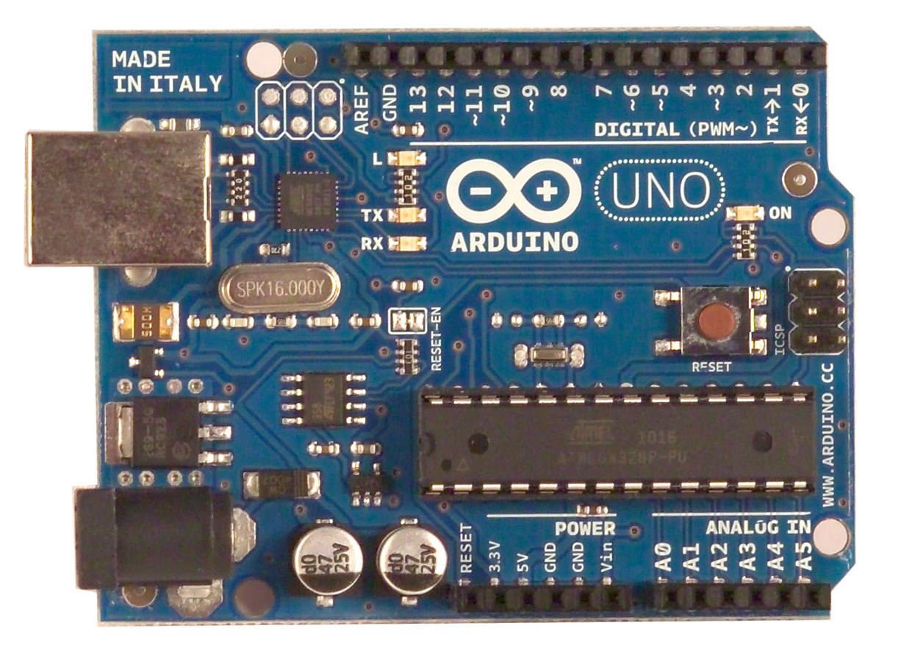
USB
Connector
Battery Connector

Slide 64
Input/Output Pins
Analog Input (6 pins)
Any value between Vmin to Vmax
For Arduino : 0 to 5 volts
Digital pins (14)
Digital Input : 0 or 5 volts
Digital Output : 0 or 5 volts
PWM output (6)
Analog output

Slide 65
Analog to digital converter
Computer uses numbers in binary form
A/D converter converts analog input into a multibit binary number
In Arduino it is 10 bit number
So 0 volts Corresponds to binary 0000000000
decimal 0
5 volts correspond to binary 1111111111
decimal 1023

Slide 66
Sampling rate of ADC in Arduino
Sampling rate = 9650 samples/Sec
Maximum theoretical frequency of the input analog signal is half of this
Other rates are also possible with advanced programming

Slide 67
PWM waveform
5
v
Tw
T
t

Slide 68
Control of duty cycle
PWM : Duty cycle
0% for 00000000 (Decimal 0)
100 % for 11111111 (Decimal 255)

Slide 69
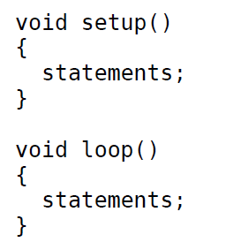
Program structure
Declarations

Slide 70
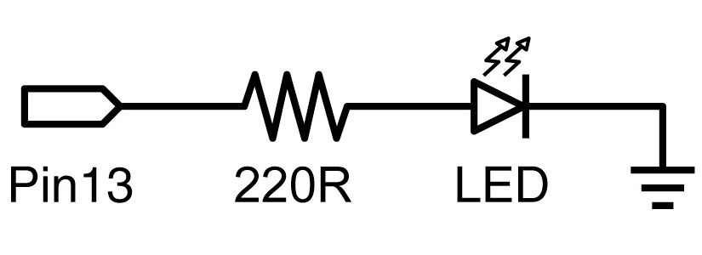
Program 1(Blinking LED)
Write a program to blink the LED. Turn it on for 1 second and turn it off for 1 second.

Slide 71
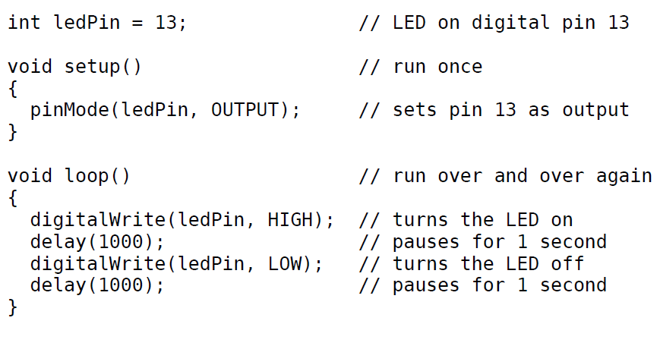
Program 1

Slide 72
Tinkercad Demo

Slide 73
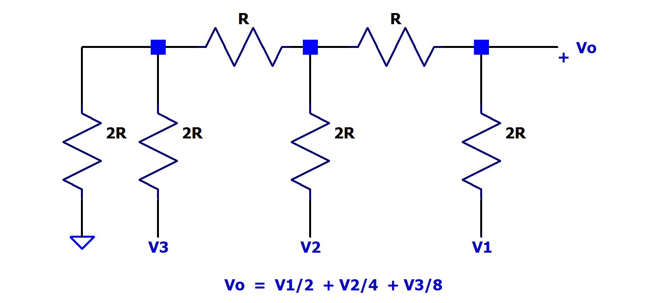
Class Exercise 3.1 3 Bit D to A converter
V1 | V2 | V3 | Vo
0 | 0 | 0 | 0
0 | 0 | V | V/8
0 | V | 0 | V/4
0 | V | V | 3V/8
V | 0 | 0 | V/2
V | 0 | V | 5V/8
V | V | 0 | 6V/8
V | V | V | 7V/8
Build in Tinkercad and test. Chose R = 1Kohms
(Other values are also possible). Use three slide switches to give digital inputs. Use a multimeter to measure the output and verify the table

Slide 74
Solution follows

Slide 75
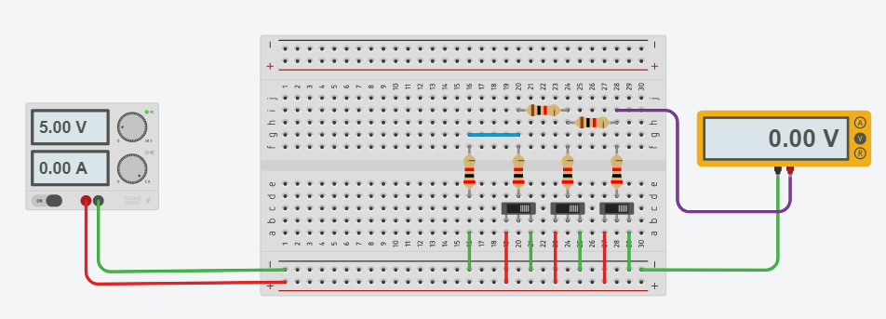
All inputs zero
V₃=0
V₂=0
V₁=0

Slide 76
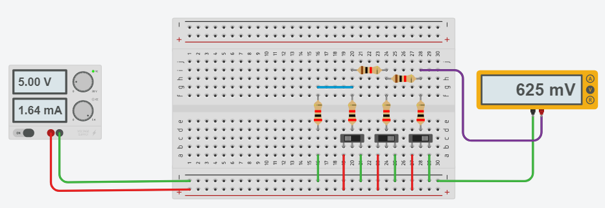
Input 00V
V₃=5
V₂=0
V₁=0
Vo = V/8 = 5/8 = 0.625 volts= 625 mVolts

Slide 77
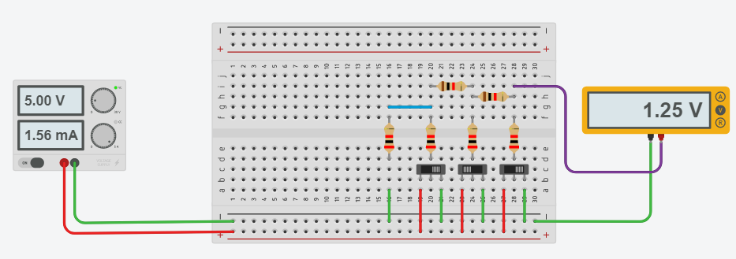
Input 0V0
V₃=0
V₂=5
V₁=0
Vo = V/4 = 5/4 = 1.25 volts

Slide 78

Input V00
V₃=0
V₂=0
V₁=5
Vo = V/2 = 5/2 = 2.5 volts

Slide 79
Sensors, Instruments and Experimentation
04 Arduino exercises
By Ashok Ranade

Slide 80
Digital Read function
Syntax
digitalRead(pin)
Description
Reads the value from a specified digital pin,
either HIGH or LOW.
x = digitalRead(Inpin)

Slide 81
Class Exercise 4.1
Write a program to sense a slide switch. If it is connected to +5 , led connected to pin 12 flashes periodically. Otherwise the led remains off.

Slide 82
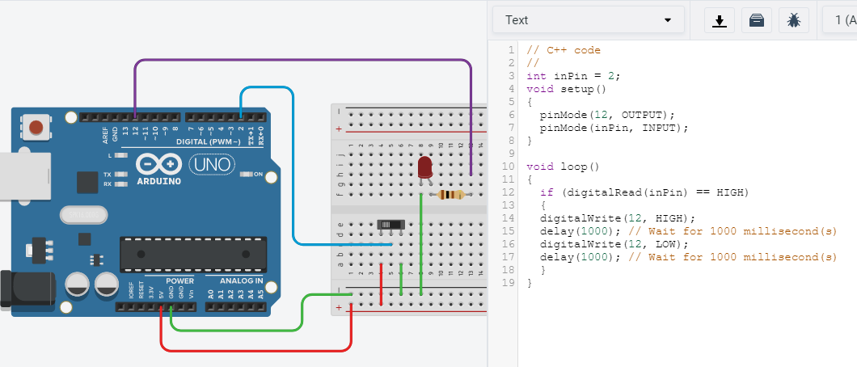
Tinkercad simulator

Slide 83
Analog Read and Serial Communication
analogRead(potPin)
x = analogRead(potPin);
x ranges from 0 to 1023
This will read the analog voltage from the input pin
Serial.begin(9600)
This will establish serial communication between
computer monitor and Arduino. This is in the set up
section.
Serial.println("ADC output");
Serial.println(x);

Slide 84
Digital to Analog Conversion calculation
Digital Value | Analog Value
0 | 0
100 | 0.488758553
200 | 0.977517107
300 | 1.46627566
400 | 1.955034213
500 | 2.443792766
600 | 2.93255132
700 | 3.421309873
800 | 3.910068426
900 | 4.398826979
1023 | 5

Slide 85
An Exercise 4.2
A potentiometer is used to generate a voltage varying between 0 and 5 volts.
The output of the potentiometer is connected to one analog input pin of Arduino. This voltage is measured by a meter.
Write a program to read the output of the potentiometer. As pot output is varied from 0 to 5 volts, the value read varies from 0 to 1023.
Next the digital value is converted to analog by using the equation. Both values are displayed on monitor. The analog value should match that of meter

Slide 86
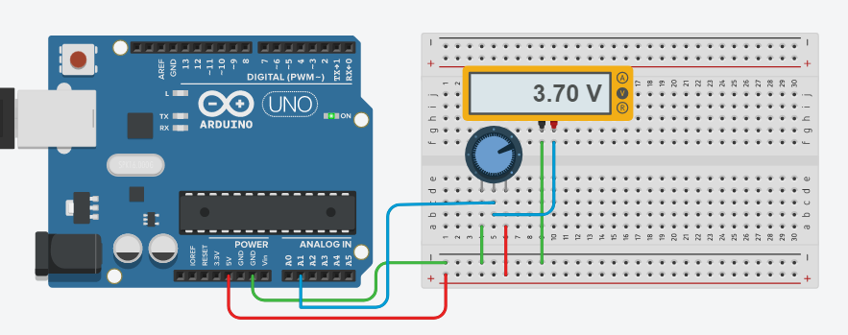
Circuit and program

Slide 87
Program
void loop()
{
Vi = analogRead(A1);
Vo = (5.0/1023.0)*Vi;
Serial.println(“Digital Value");
Serial.println(Vi);
Serial.println();
Serial.println(“Analog Value");
Serial.println(Vo);
Serial.println();
delay(2000);
}
int Vi;
float Vo;
void setup()
{
Serial.begin(9600);
}

Slide 88
analogWrite function
Certain digital pins can be used as PWM pins
analogWrite( pin number, value);
value is an integer from 0 to 255
Decides the duty cycle of the PWM waveform
value 0 means 0% duty cycle
255 means 100% duty cycle

Slide 89
PWM waveform
5
v
Tw
T
t

Slide 90
Average value
analogWrite( pin number, value);

Slide 91
Value and average value
Value | Average Value
0 | 0
25 | 0.490196078
50 | 0.980392157
75 | 1.470588235
100 | 1.960784314
125 | 2.450980392
150 | 2.941176471
175 | 3.431372549
200 | 3.921568627
225 | 4.411764706
255 | 5

Slide 92
Average calculation
analogWrite( pin number, value);
Examples

Slide 93
Class Exercise 4.3
This exercise will demonstrate how the average value from a PWM output can be extracted by using a low pass first order filter
Use pin no 11 as output pin. Connect the output of pin no 11 to the R-C low pass filter
Use pin no 2 as the digital input pin. And use a slide switch which will enable you to connect either +5 or Ground to the input pin no 2.
Write a program to generate two different average values from pin no 11 for two settings of the slide switch.

Slide 94
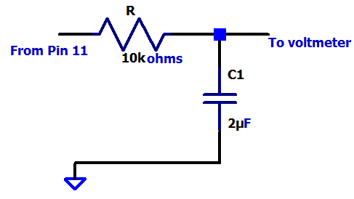
Interface circuit
Time constant 20 mS
+5 volts
From Digital pin 2
Ground

Slide 95
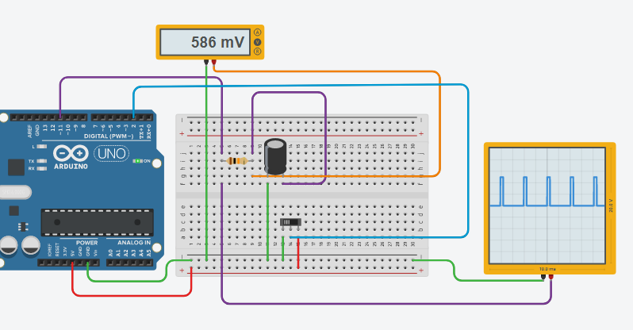
Connections

Slide 96
Program
void loop()
{
x = digitalRead(2);
if (x == 1)
{
analogWrite(11,127);
}
else
{
analogWrite(11, 31);
}
}
bool x;
void setup()
{
pinMode(11, OUTPUT);
}

Slide 97
Control systems
Ashok Ranade

Slide 98
Control system
What is a control system ?
It is a system which controls a physical quantity such as temperature or position
An example
Toaster
Function is to bring the bread slices to a desired
temperature so that they are nice golden brown.
Set the timer and put the supply on.
Next : Parts of a control system

Slide 99

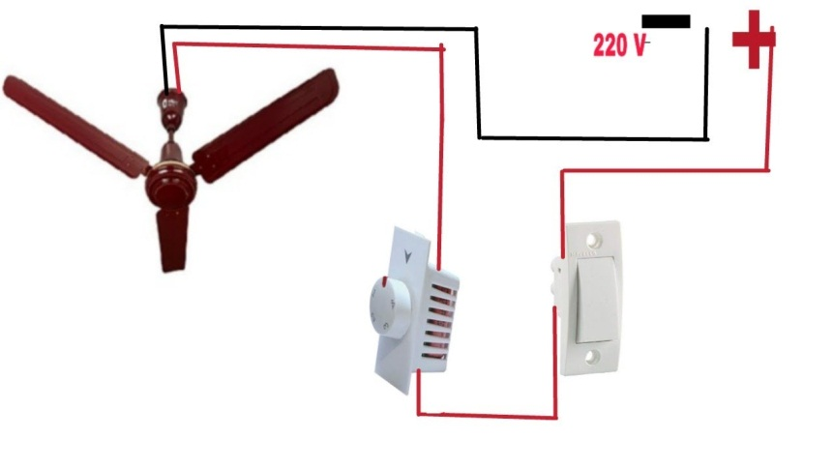
Parts of a control system
Control element
Timer
Plant
Heating coil
Control element
Regulator
Plant
Motor
Next : Open loop control system

Slide 100
Open loop control systems
The control action is independent of the controlled
variable
Timer setting is assumed to be correct
But it may have to be different in winter compared
to summer
Also plant characteristics might change due to ageing
Reference input
Plant
Controlled variable
Controller
Next : Closed Loop control system

Slide 101
Closed loop control system
Manual control
User adjusts a small time on timer
The user inspects the slices at the end of time
If not done he/she sets the time again and repeats
until done
Control action now depends on the output variable
Feedback is used in automatic control systems
Next : Speed control of DC motor

Slide 102
Speed control of a DC Motor
Variable DC voltage
DC Motor
Speed is proportional to DC voltage.
Input DC source can be calibrated in terms of speed.
The knob is set to the desired speed
Speed might change due to change in the load or ageing

Slide 103
Manual Control
Variable DC voltage
DC Motor
Speed Sensor
Meter

Slide 104
Automatic control
Vs
DC Motor
Speed Sensor
+
A
-
Meter
V_{f}
Sensor Characteristics
Speed | Vf
1000 rpm | 1 volt
2000 rpm | 2 volt

Slide 105
Steady state calculation
Vs
DC Motor
Speed Sensor
+
A
-
Meter
V_{f}
K_{s} = V_{f}/N

Slide 106
Exercise 5.1
A dc motor has linear characteristics between input voltage and speed. Two points on this characteristics are
N = 600 rpm when V = 15 volts
N = 800 rpm when V = 20 volts
(1) Find the equation between speed and the
voltage.
(2) when loaded the proportionality constant between
speed and voltage becomes 1/3 of the no load
value. Find the new speed at V = 15 volts and find
the % change in the speed compared to no load

Slide 107
Solution

Slide 108
Exercise 5.2
Vs
DC Motor
Speed Sensor
+
A
-
Meter
V_{f}
Consider the above closed loop system.
Km = 40 and Ks = 1/160. Find the speed of the motor when
Vs = 5 volts and A = 10
the motor is loaded and Km drops to 40/3
Also find % change in speed

Slide 109
Solution to Exercise 5.2

Slide 110
Exercise 5.3
Repeat Exercise 5.2 but with A = 100.

Slide 111
Answers
With A =100
On No load
Vf | 4.807692
N | 769.2308
With load
Vf | 4.464286
N | 714.2857
% Change | -7.14286

Slide 112
Specification of control systems
Accuracy of the output in steady state
Suppose desired temperature is 50 degrees
In a certain system the output could be within 1 %
Speed of response
How fast the desired output is achieved ?
One system : 5 minutes
Another system : 10 minutes
Feedback will help improve both
Next : An example of modelling

Slide 113
Steps in analysis of control systems
From the block diagram set up the differential equation for the system
Solve the differential equation
Find the steady state error
Find the speed of response
The differential equation can be
First order
Second order or higher order

Slide 114
Block diagram of an oven
Thermo Couple
Heating Element
Next : Thermal resistance

Slide 115
Thermal resistance and capacitance
When the power is supplied the temperature in the oven increases
The rate of increase depends on thermal resistance and thermal capacitance
Thermal resistance
This impedes the heat flow(Energy/unit time) from
oven to outside
Depends on the materials and geometry
Note R is in degrees/Watt

Slide 116
Thermal capacitance
Consider an oven with no leakage
The temperature in the oven will start with ambient temperature and increase as the heat energy in creases with time. Thus the heat energy is being stored.
Larger the volume , smaller will be the rate of increase of temperature
C is in watt-sec/degree

Slide 117
Mathematical model of the oven
Heat in = Heat out + Heat Stored
Next : An example of steady state calculations

Slide 118
Steady state calculations
In steady state , the temperature in the oven becomes constant and the equation is
A sample calculation
Suppose we want and .
Also R = 0.05 Degrees/ Watt
Coil wattage q = 40/0.05 = 800 watts

Slide 119
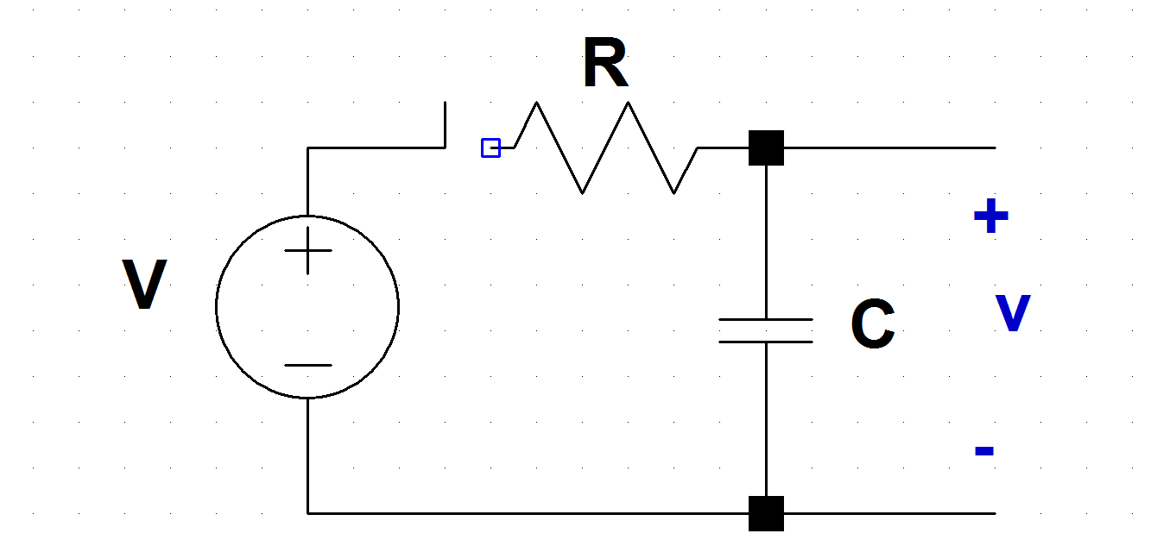
Electrical Equivalent circuit
Temperature : Voltage
Thermal resistance : Electrical resistance
Thermal capacitance : Electrical capacitance

Slide 120
Set point
Note that θ reaches qR in steady state. This the desired temperature. Hence qR is called the set point
In the electrical Analog V is the set point
Next : Closed loop system

Slide 121
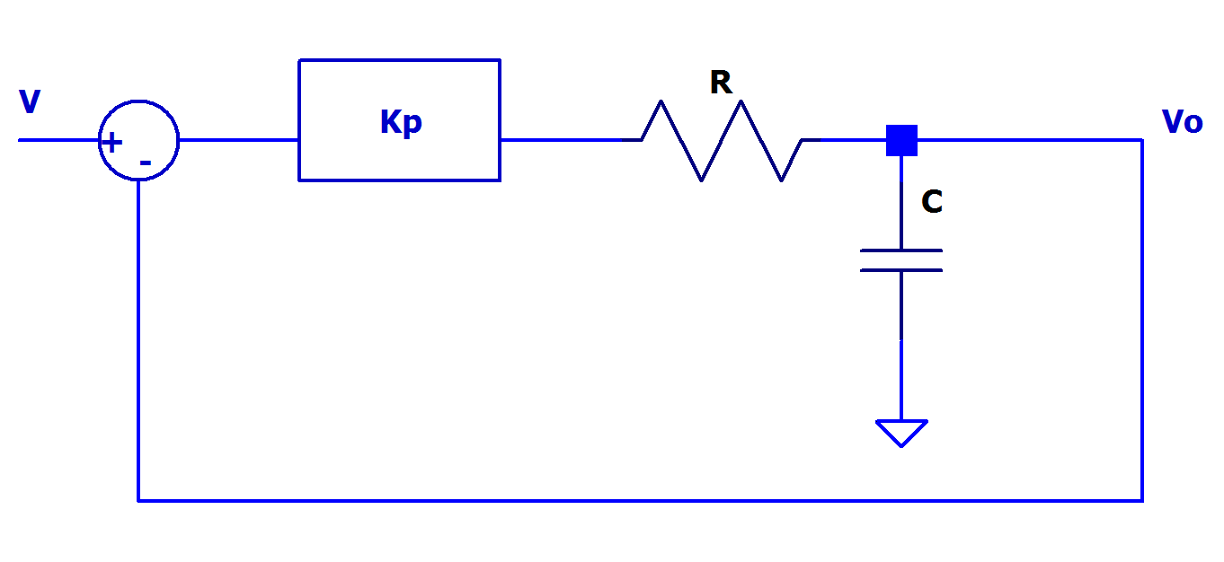
Closed Loop System

Slide 122
Effect of proportional control
Time constant is reduced. Faster Response
Steady state error

Slide 123
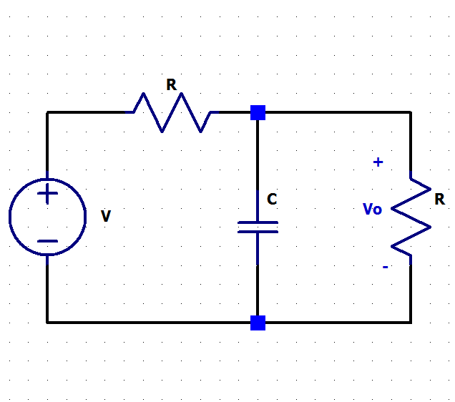
Loading effect in Open loop System
Steady state voltage is reduced to half the value.

Slide 124
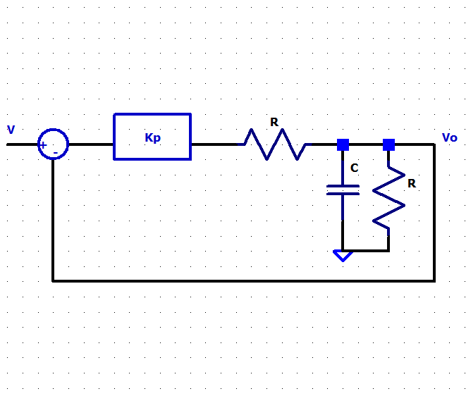
Loaded system with feedback

Slide 125
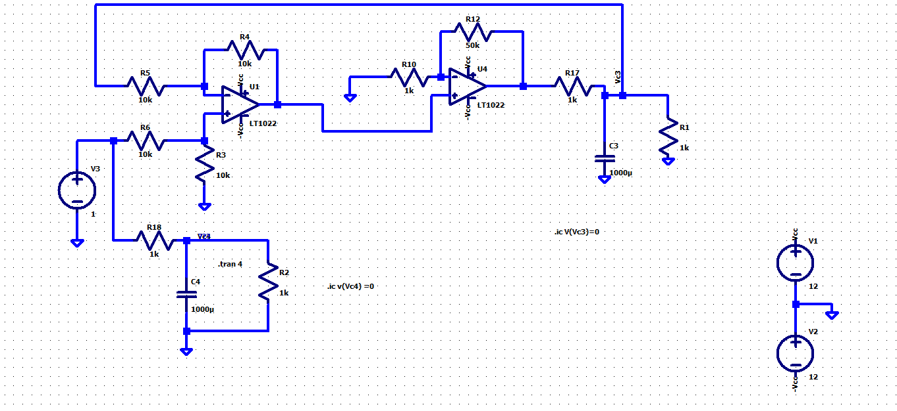
LTspice simulation

Slide 126
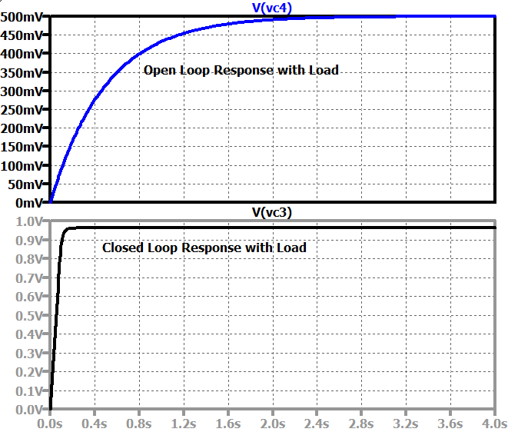
Step response

Slide 127
Exercise 5.4
In the Ltspice simulation shown the load is the first order low pass filter consisting of 1kohms resistor, 1000 μF capacitor and the load of 1 kohms resistor
Replace this load by a second order low pass filter consisting of 20 kohms resistor, 0.1 H inductor and 1μF capacitor. Use a load of 40 kohms resistor and plot the transient response for open loop and closed loop circuit and compare.
Write your conclusions.

Slide 128
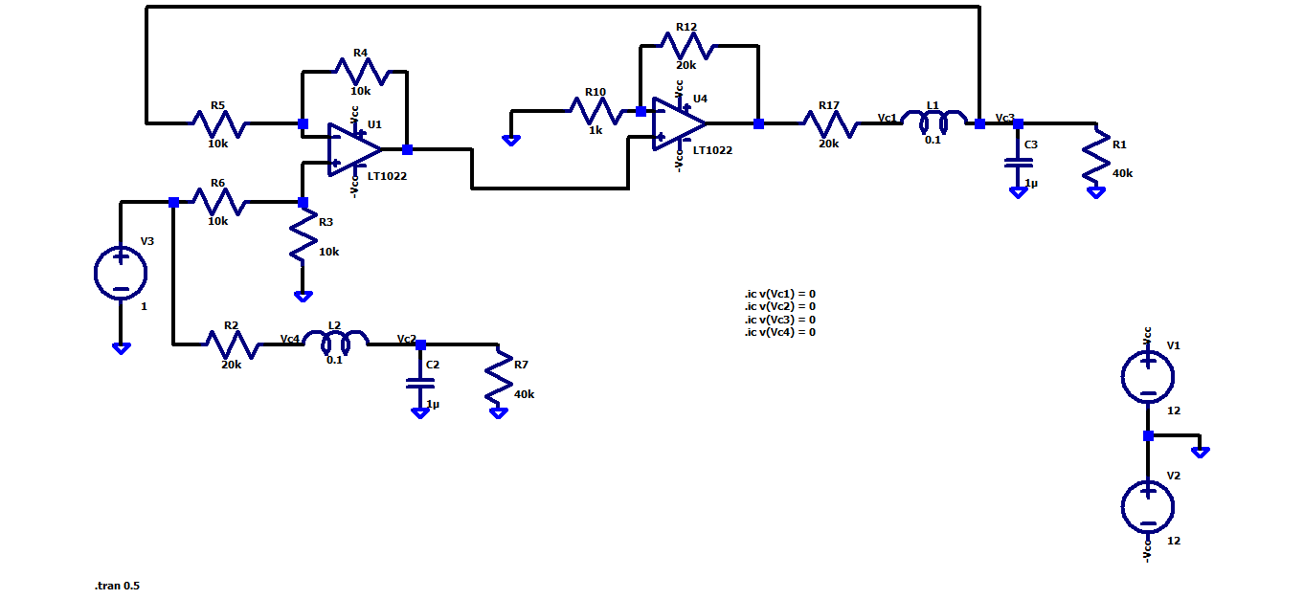
Solution to Exercise 5.4

Slide 129
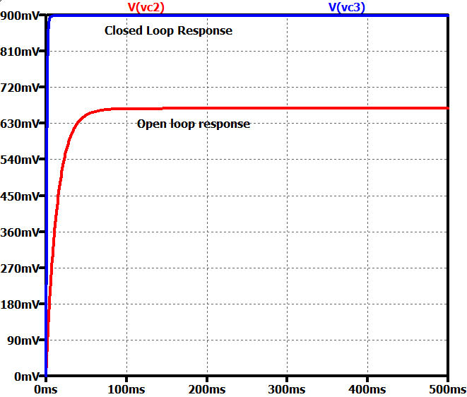
Open loop and closed loop outputs

Slide 130
Sensors, Instruments and Experimentation
07 Concepts of Stress
and Strain
By Ashok Ranade

Slide 131
Hook’s Law
When you apply a Force to an object, it moves if free to move
If it is not free to move, it gets deformed.
Hook’s law (Applies when deformation is small)
F is the force applied
k constant depending on shape and composition of
the object and the direction of the force
The amount of deformation

Slide 132
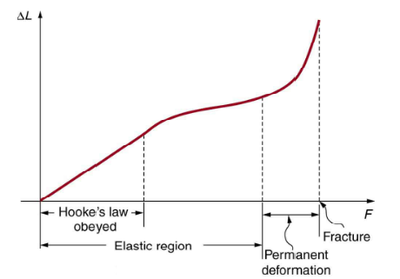
Deformation vs Force

Slide 133
Axial and transverse strain Tensile force
F
Typically
Lies between 0 to 0.5
F

Slide 134
Compressive Force
F
F

Slide 135
Young’s modulus
F
A : Cross sectional area
Y : Young’s Modulus
Stress = Y x Strain
F

Slide 136
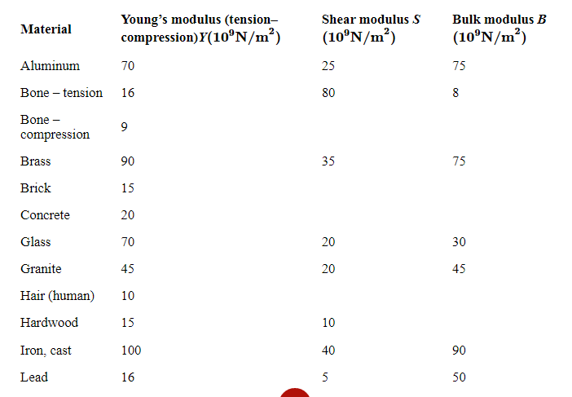
Young’s modulus for various materials

Slide 137

Exercise 7.1
A sculpture weighing 10,000 N rests on a horizontal surface at the top of a 6.0-m-tall vertical pillar. The pillar’s cross-sectional area is 0.20 m² and it is made of granite with a mass density of 2700 kg/m³ . Find the compressive stress at the cross-section located 3.0 m below the top of the pillar and the value of the compressive strain of the top 3.0-m segment of the pillar.

Slide 138
Solution
The volume of the pillar segment with height h = 3.0 m and cross-sectional area A = 0.20 m² is
V = Ah = 0.6 m³
With the density of granite = 2.7 x 10³kg/m³ , the mass of the pillar segment is
m = ρV = 1.6x10³ Kg
The weight of the pillar segment is
w = mg=1.568x10⁴ N

Slide 139
Solution continued
The weight of the sculpture is w = 1.0 x 10⁴ N
So the normal force acting
wp+ws = 2.568x10⁴ N
Stress = F/A = 2.568x10⁴/0.2 = = 128.4 kPa
Y for granite= 4.5x10⁷ kPa
Strain = Stress/Y= 2.85x10⁻⁶
Note that the stress will be maximum at base

Slide 140
Exercise 7.2
A 2.0-m-long steel rod has a cross-sectional area of 0.30cm² The rod is a part of a vertical support that holds a heavy 550-kg platform that hangs attached to the rod’s lower end. Ignoring the weight of the rod, what is the tensile stress in the rod and the elongation of the rod under the stress?

Slide 141
Answers
Procedure
Calculate F/A
Young’s modulus for steel is Y =2.0×10¹¹Pa.
Calculate ΔL

Slide 142
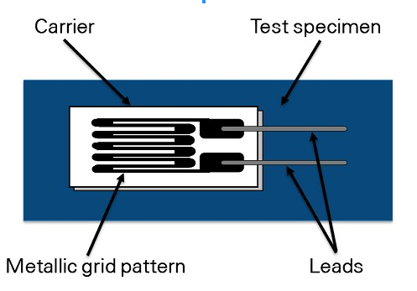
Strain gauge
Epoxy adhesives
Special plastic
Tension will increase the resistance

Slide 143
Strain gauge
Epoxy adhesives
Special plastic
Compression will decrease the resistance

Slide 144
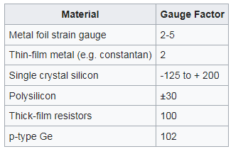
Various gage factors

Slide 145
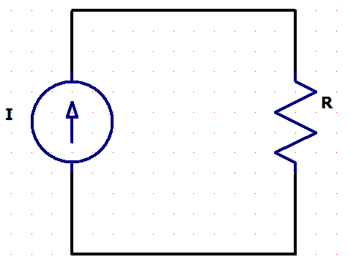
Simple method of strain measurement
Voltage can be calibrated in terms of strain. But measurement will be very difficult since ΔR/R is very small compared to one.
Strain gage
Voltage across the strain gauge is

Slide 146
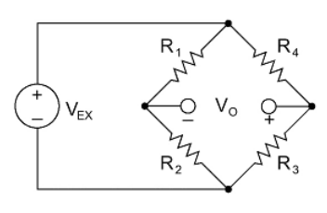
Bridge circuit

Slide 147
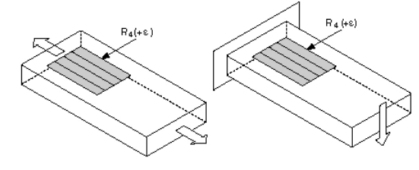
Quarter Bridge Configuration 1
Axial or bending strain

Slide 148
Quarter bridge Configuration 1

Slide 149
Calculation for strain

Slide 150
Exercise 7.3
Assume a quarter bridge driven by a 9 volt battery
Gauge factor has the value of 3
Next assume that a variable tensile force is applied
This force is adjusted to get the output voltage from 0 to – 130 mvolts in steps of -10 mVolts
Using a spreadsheet calculate the strain values for each of the output observed

Slide 151
Answers
Vo | Strain(%)
0 | 0
-10 | 0.148478099
-20 | 0.297619048
-30 | 0.447427293
-40 | 0.597907324
-50 | 0.74906367
-60 | 0.900900901
-70 | 1.053423627
-80 | 1.206636501
-90 | 1.360544218
-100 | 1.515151515
-110 | 1.670463174
-120 | 1.826484018
-130 | 1.983218917

Slide 152
Exercise 7.4
Next set up a quarter bridge circuit in Tinkercad to measure the output voltage from the bridge. Use 100 ohms bridge resistors and a 9 volt battery.
Since Tinkercad does not have strain gage use a variable resistance varying from 0 to 6 ohms to represent the strain gauge.
Use an identical resistance in the other arm to compensate for a possible offset.
Vary the resistance and record the output voltage

Slide 153
Exercise 7.3 continued
What is the value of output voltage you expect when the resistance is set to 6 ohms? Explain your answer.

Slide 154
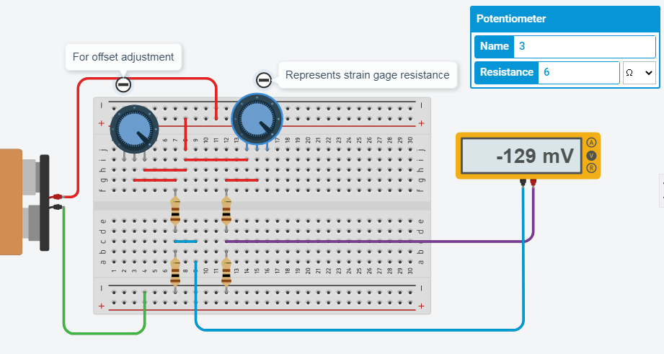
Solution

Slide 155
Solution continued
From the table in the spreadsheet we expect the output of about -130 mV. We get -129 mV

Slide 156
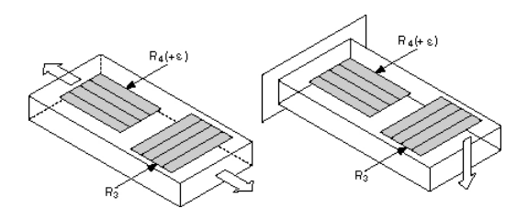
Quarter Bridge configuration 2
Axial or Bending strain
R3 is mounted in close thermal contact
but not bonded to the specimen.
So strain does not affect R3 but temperature
Effects are cancelled since ratio of R3 to R4
becomes independent of temperature

Slide 157
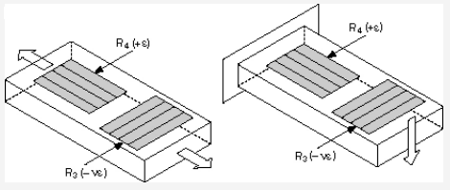
Half bridge Strain gage Axial or bending strain
R3 is mounted in close thermal contact
and bonded to the specimen.
Temp effects are cancelled since ratio of R3 to R4
becomes independent of temperature
v is the Poisson ratio

Slide 158
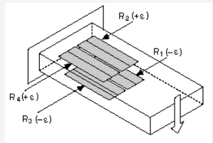
Full Bridge (Bending strain only)

Slide 159
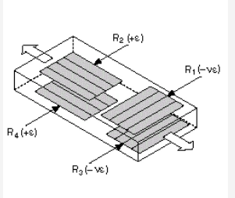
Full Bridge (Axial strain)

Slide 160
Sensors, Instruments and Experimentation
17 Force sensing Resistance
By Ashok Ranade

Slide 161
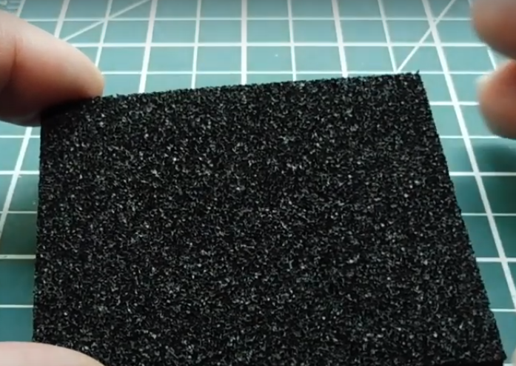
Principles of Force sense resistor
Conducting foam. Polyethylene foam filled with carbon.
When pressed the contact resistance will decrease.

Slide 162
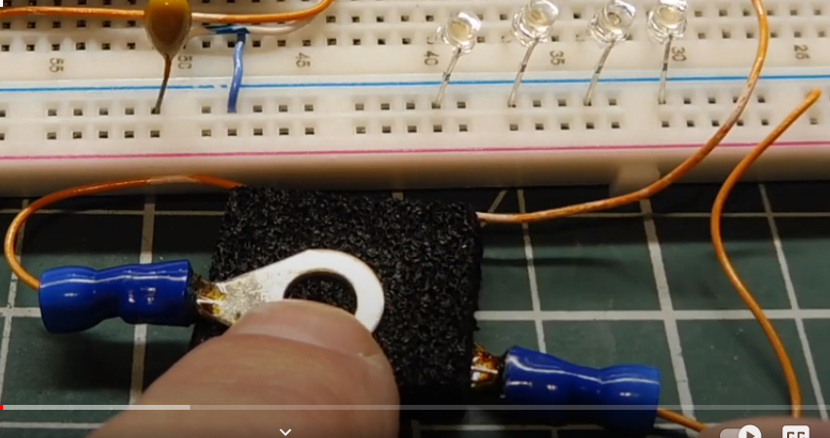
Foam used as resistor

Slide 163
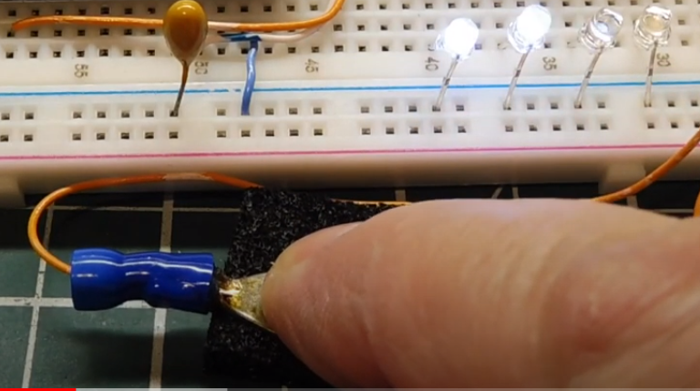
Resistance change detected

Slide 164

Conducting grid
A polyester film with printed circuit
Conducting fingers

Slide 165

Two types of FSR
Thru mode more sensitive to light forces and more linear. Costlier
Conducting sheet is polymer sheet with carbon ink

Slide 166

Tinkercad simulation

Slide 167
Force vs Resistance characteristics
F(Newtons) | R(Kohms)
0.1 | 64.2
0.18 | 33.2
0.32 | 16.5
0.39 | 13.3
0.88 | 6.58
1.76 | 4.03
3.09 | 2.72
4.81 | 2
6.76 | 1.58
8.48 | 1.34
10 | 1.2

Slide 168


Force vs voltage

Slide 169

Tinkercad simulation

Slide 170
Force vs output voltage
F(Newtons) | R(Kohms) | Vo = 12*(1/(1+R)
0.1 | 64.2 | 0.18404908
0.18 | 33.2 | 0.350877193
0.32 | 16.5 | 0.685714286
0.39 | 13.3 | 0.839160839
0.88 | 6.58 | 1.583113456
1.76 | 4.03 | 2.385685885
3.09 | 2.72 | 3.225806452
4.81 | 2 | 4
6.76 | 1.58 | 4.651162791
8.48 | 1.34 | 5.128205128
10 | 1.2 | 5.454545455

Slide 171

Force alarm
In this circuit if Force exceeds a certain value an alarm is given in the form of lighting the LED
V_{ref}= 4 volts
4.81 Newtons

Slide 172

Tinkercad Simulation

Slide 173
Exercise
Design and build a force-meter
Use the suggested circuit for sensing the force
Use an analog pin to read the input
Use curve-fitting to convert the input into force in Newtons.

Slide 174
Solution
A crude solution is given in the next few slides.
The calibration is good only for larger values of Force
Students are expected to do better curve fitting

Slide 175

Force-meter circuit

Slide 176
Program
void loop()
{
V = analogRead(1);
if (V < 145)
{
F = 0.000018* V*V + 0.0042122*V;
}
else if(V >= 145 && V <= 260)
{
F = 0.0000417*V*V+0.0013314*V +0.30588 ;
}
else
{
F = 0.0000832*V*V-0.0256711*V+3.8517;
}
Serial.println(F);
}
float(F);
float(V);
void setup()
{
Serial.begin(9600);
}

Slide 177

Output

Slide 178
Sensors, Instruments and Experimentation
14 Potentiometer
as position transducer
By Ashok Ranade

Slide 179

Potentiometer

Slide 180
Potentiometer constant

Slide 181

Converting change of resistance into a change of voltage

Slide 182
Application in an automobile
When accelerator pedal is pressed in an automobile throttle valve opens wider allowing more air to go in the engine providing larger energy.
Precise control of throttle valve can be obtained by using feedback
Two potentiometers are used. One to sense the pedal position and the other to sense throttle valve position.

Slide 183
Feedback control
Pulse
Width
Modulator
Throttle valve and sensor
Motor
+
-
From Pedal pot

Slide 184

Pulse width modulation
More efficient than using a DC amplifier

Slide 185

Throttle valve

Slide 186
Throttle valve angle and Potentiometer output
At 0 degrees the throttle valve is closed. At 90 degrees it is fully open.

Slide 187
Pedal angle and Potentiometer output
At 0 degrees the accelerator is
un-pressed. At 45 degrees it is fully pressed.

Slide 188
Angle measurement using arduino Exercise 9.1
Interface a potentiometer to Arduino in Tinkercad using analog input pin.
Note that potentiometer goes from zero degrees to 270 degrees.
Write the program to read the input from the potentiometer and display the angle on serial monitor

Slide 189

Angle measurement

Slide 190
DC motor control using Arduino
A dc motor is interfaced to Arduino
The speed of the dc motor will depend on the applied voltage
Direction of the rotation will depend on the direction of current through the winding.
Direction of rotation can be reversed using a H bridge

Slide 191

H bridge
S2, S3 open
S1, S4 closed
Current flows from left to right
S2,S3 closed
S1, S4 open
Current flows from right to left reversing the direction of rotation

Slide 192


H Bridge IC
This can control two motors
Vcc1 should be +5 volts. This is used for logic circuits.
Voltage to Vcc2 is for the motor. This can have values from 4.5 volts to 36 volts.
Out1 and Out2 go to motor terminals.
IN1 and IN2 control direction of rotation as follows
When ENA is high the motor runs. When it is low the motor stops. So if a PWM waveform is connected to ENA speed can be controlled through duty cycle
Similar controls for the second motor

Slide 193
Exercise 9.2
Design the hardware and software interface to arduino for direction and speed control of a dc motor. (Use hobby gear-motor in Tinkercad)
Use a potentiometer and an analog input pin to provide a variable voltage to the Arduino. In the program scale this so as to generate a PWM signal of variable duty cycle to be connected to Enable pin.
Use a slide switch to generate a digital input. If this is high motor should run in one direction. Otherwise in the opposite direction.

Slide 194

Hardware interface

Slide 195
float x; float y;
void setup()
{
pinMode(11, OUTPUT);
pinMode(4, OUTPUT);
pinMode(2, OUTPUT);
}
void loop()
{
if (digitalRead(7) == HIGH)
{
digitalWrite(4,HIGH);
digitalWrite(2,LOW);
}
else
{
digitalWrite(4,LOW);
digitalWrite(2,HIGH);
}
x = analogRead(A1);
y = x*255/1023 ;
analogWrite(11,y);
}

Slide 196
Sensors, Instruments and Experimentation
10 Temperature
Detectors
By Ashok Ranade

Slide 197
Resistance temperature detectors (RTD)
RTD is a resistance which depends on temperature
RTDs can be made with both positive and negative temperature coefficients.
To develop a voltage proportional to temperature a current source is required

Slide 198

Platinum RTDs
Platinum has high resistivity
1.06×10⁻7 ohm-meter at 20⁰C
R_{T} = [R_{o} + (αR_{o}ΔT)]
= 0.00385 Ω/Ω/°C at 0°C
A typical value R₀ = 100 ohms

Slide 199
Approximate relationship
T | 0 | 100 | 200 | 300 | 400 | 500 | 600 | 700 | 800
RTD | 100 | 138.5 | 177 | 215.5 | 254 | 292.5 | 331 | 369.5 | 408
Resistance in ohms
Temp in ⁰C

Slide 200
Temperature calculation
T
RTD

Slide 201
Line resistance effect
Heated chamber
RTD
Current source
Voltmeter
Calibrated in temperature
Monitoring place
If the distance between monitoring place and the chamber is large line resistances will cause error

Slide 202
4-Wire RTD measurement
Heated chamber
RTD
Current source
Voltmeter
Calibrated in temperature
Monitoring place
Voltmeter has large resistance so very little current flows through measurement wires

Slide 203
Resistance as a function of temperature
A better approximation is
R = R₀(1 + AT – BT² - CT³)
A = 3.6962x10⁻³ : B = 5.8494x10⁻⁷
C = 4.2325x10⁻¹²

Slide 204

Thermocouples
Thermocouple is basically a junction of two dissimilar metals and gives a voltage depending on the temperature of the junction
Discovered by Thomas Seebeck in 1821

Slide 205

Types
The first metal has +ve polarity

Slide 206
Merits and demerits
Much higher temperature range compared to RTD
Much more rugged
Non-linear characteristics
Less accurate.

Slide 207
Reference(Cold) junction
There is one hot junction and two cold junctions. The output voltage is the resultant of all the voltages produced. But if the reference junctions are kept at zero degree centigrade their voltages are zero and the output voltage corresponds to the temperature of hot junction.

Slide 208

Calibration

Slide 209
Polynomial for J thermocouple
T = -0.048868252 + 19873.14503 v - 128614.5353 v² + 11569199.78 v³ - 264917531.4 v⁴ + 2018441314 v⁵

Slide 210
Polynomial for J thermocouple
V in volts
T in degrees C
v | 0 | 0.01 | 0.02 | 0.03 | 0.04 | 0.05 | 0.06
T | -0.05 | 194.9 | 402.6 | 627.2 | 858 | 1093 | 1364

Slide 211
Reference junction compensation
+
+
+ VC1 -
VH
_
-
+ VC2 -
The temperature of the reference junction is regulated at some convenient value. Hence VC1 and VC2 are known .V is measured. Note that polarities shown are assumed polarities. They could be different for different type of junctions.
VH = VC1 + V – VC2
From the characteristics of the thermocouple T1 can be calculated

Slide 212
Automatic junction compensation
Algorithm
Read V_{out} through an ADC
Read cold junction temperature
Calculate V₁ and V₂
Calculate
V_{T} = V₁ + V_{out} –V₂
(5) Calculate the hot junction
temperature
(6) Display temperature
(7) Delay
(8) Go to (1)
Display
44.9⁰C
Processor
+
+ V₁ -
+
Vout
₋
V_{T}
+ V₂ -
-
Cold J unction Temp
Measurement
Integrated circuit or
RTD circuit
The polarities of V_{T}, V₁ and V₂ depend on the metals

Slide 213
Temperature sensor TMP 36
Low voltage operation (2.7 V to 5.5 V)
Calibrated directly in °C
10 mV/°C scale factor (20 mV/°C on TMP37)
±2°C accuracy over temperature (typ)
±0.5°C linearity (typ)
Stable with large capacitive loads
Specified −40°C to +125°C, operation to +150°C
Less than 50 μA quiescent current
Shutdown current 0.5 μA max
Low self-heating
Qualified for automotive applications
When Temp = -40⁰C Vo = 100 mV
When Temp = 125⁰C Vo = 1750 mV

Slide 214
Exercise 10.1
Interface the IC TMP 36 to arduino in Tinkercad
IC has three terminals. Vcc, Ground and Vout
Use an analog pin to read the output of TMP 36
Perform necessary calculation to obtain the temperature
Display the temperature on the serial monitor
Note that you will see a slider on top of the IC once the simulation has started. This can be used to change the temperature.
In actual application the temperature is decided by the surroundings

Slide 215
Calculation required
The value read (say, Vd) by the analogRead command will be the digital value ranging from 0 to 1023. And it will be 1023 when the input voltage is 5 volts. So the realtion between Vd and Vo is given by

Slide 216

Solution (Minimum Temperature)

Slide 217

Highest temperature

